Slide 1
Collection ESCC gene sets
First pass (02/14/2020)

Slide 2
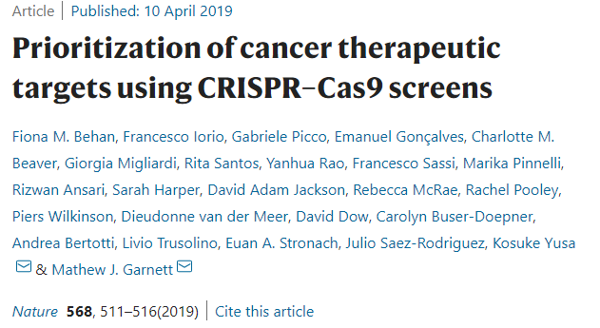
ESCC cell lines from CRISPR-Cas9 screens
Genes appear in all 19 cell line: 374
Genes appear in all 18 or more: 561
Genes appear in all 15 or more: 945
Genes appear in all 10 or more: 1353
Genes appear in at least 1: 3435
There are 27 Esophagus cell lines,
Of which 20 are Esophageal Squamous Cell Carcinoma (ESCC)
19 out of 20 have the “fitness genes”
https://www.nature.com/articles/s41586-019-1103-9#Sec44

Slide 3
Our current collections
hsNRF2highESCC: human NRF2-high ESCC gene set
Total 257 human genes collected
hsNRF2highESCC
mmNRF2ChIPseqES: mouse esophagus NRF2 ChIPseq gene set
Nrf2 ChIP-seq from mouse study: Nrf2KO, WT and Keep1KO
Total 1940 genes (WT has 81, and Keep1KO has 1923)
Found 1559 human gene homologous (biomaRt)
mmNRF2ChIPseqES_hsHomolog
mmNRF2ChIPseqES_hsHomolog
Human homolog from mmNRF2ChIPseqES
Total 1559 human gene homologs

Slide 4
mm2hsChIPSeq
Set 1: “”
(in all 19 ESCC )

Slide 5
mm2hsChIPSeq
Set 3: “”
Set 2: “”
(in any of the 19 ESCC )

Slide 6
Our extended collections
hsNRF2highESCC: human NRF2-high ESCC gene set
Total 257 human genes collected
mmNRF2ChIPseqES_hsHomolog
Human homolog from mmNRF2ChIPseqES
Total 1559 human gene homologs
Set1:
58 human genes
Set2:
42 human genes
Set3:
283 human genes

